Slide 1

Armed Forces College of Medicine
AFCM

Slide 2
ACUTE CORONARY SYNDROME

Slide 3
PREPARED BY PROF SAMEH SHAHEEN

Slide 4
Indented Learning Outcomes (ILOs)
By the end of this lecture the student will be able to:
Define and describe the epidemiology, etiology and pathophysiology of ACS.
Evaluate by history analysis and physical examination a case of ACS
Use appropriate investigations to diagnose a case of ACS.
Identify possible differential diagnosis of a case of ACS
Risk stratify a case of ACS
Describe pre-hospital and in-hospital management of a case of ACS.
Construct a post ACS care plan and counselling for secondary prevention

Slide 5
Ischemic Heart Disease (Coronary Artery Disease): Definition, etiology and epidemiology
Ischemic heart disease is a condition in which there is inadequate supply of blood and oxygen to a portion of myocardium which means, imbalance between myocardial oxygen supply and demands.
It is caused mainly by atherosclerosis, but other varieties exist:
Epicardial atherosclerotic CAD:
Vasospastic epicardial CAD (Variant angina):
Typical chest pain not triggered by exercise or emotional stress, in a patient who has no risk factors for IHD, in whom coronary angiography demonstrated transient coronary vasospasm.
Treatment: nitrates and calcium channel blockers prevent the spasm.
Microvascular angina:
Angina that occur in patients with normal coronaries and no provocative spasm.
Pathophysiology: Decrease endothelium-dependent vasodilatation.

Slide 6
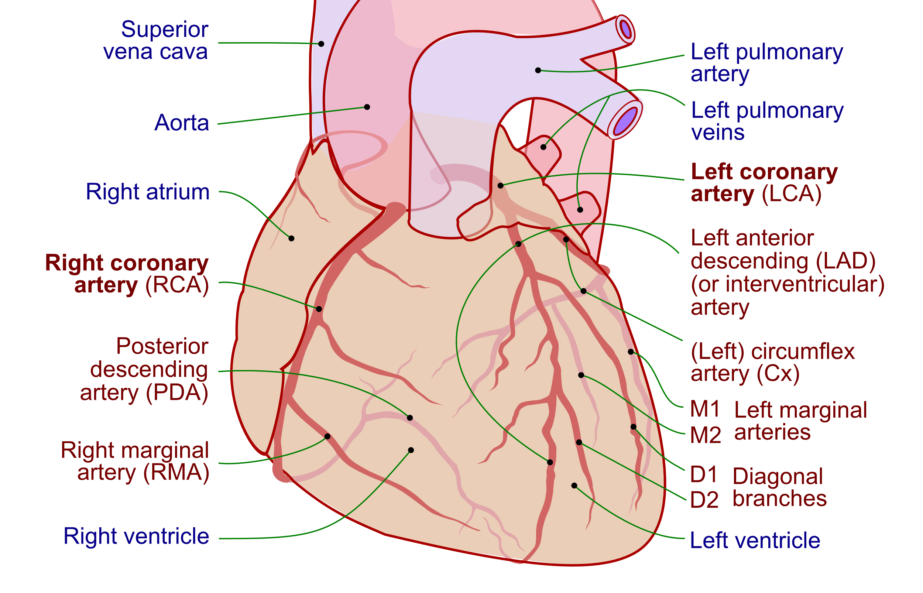
EPICARDIAL CORONARY ARTERIES
Left Main Coronary Artery (also called the left main trunk)
Right Coronary Artery (RCA)
Branches into:
Circumflex artery (CX)
Left Anterior Descending artery (LAD)
Branches into:
Right marginal artery
Posterior descending artery
Supplies:
CX: supplies blood to the left atrium, side and back of the left ventricle
LAD: supplies the front and bottom of the left ventricle and the front of the septum
Supplies:
right atrium
right ventricle
bottom portion of both ventricles and back of the septum

Slide 7
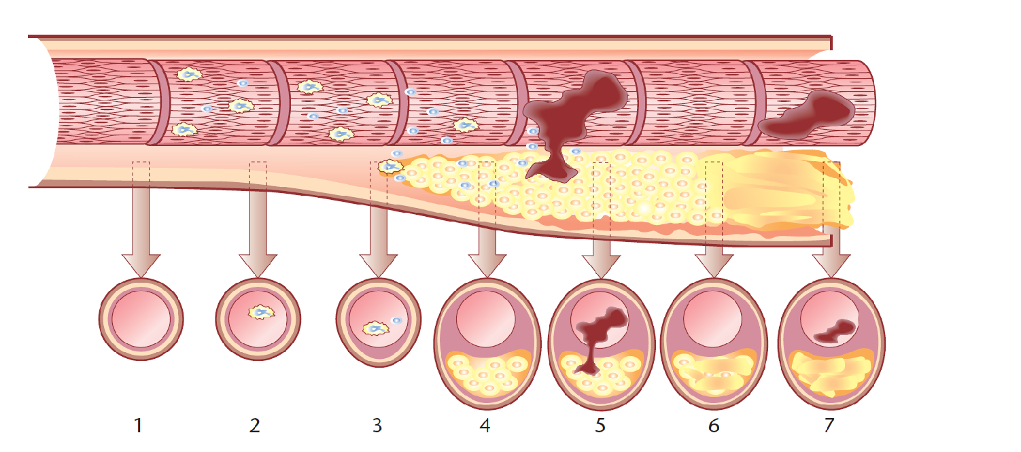
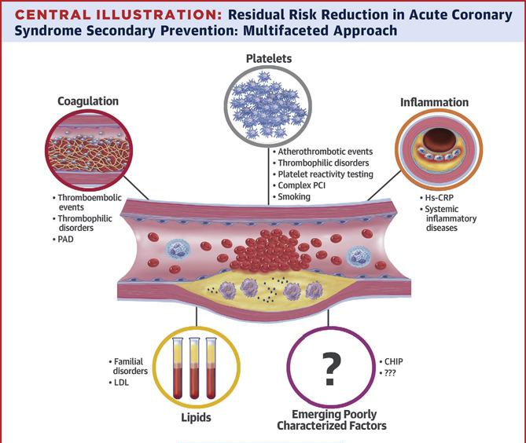
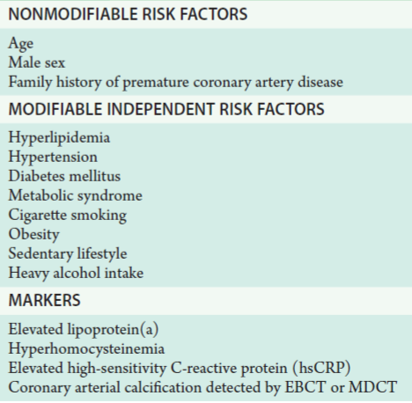
Atherosclerosis pathology
Progressive inflammatory disorder of the arterial wall, characterized by focal lipid rich deposits of atheroma.
It remains clinically asymptomatic until:
.Large enough to impair tissue perfusion .
.Ulceration or disruption of the lesion result in thrombotic occlusion.
Clinical manifestation will depend upon site of the lesion and vulnerability of the organ supplied.

Slide 8
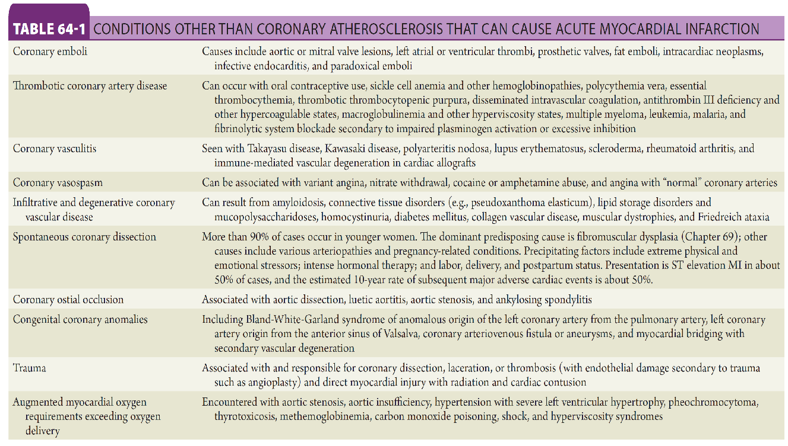

Slide 9
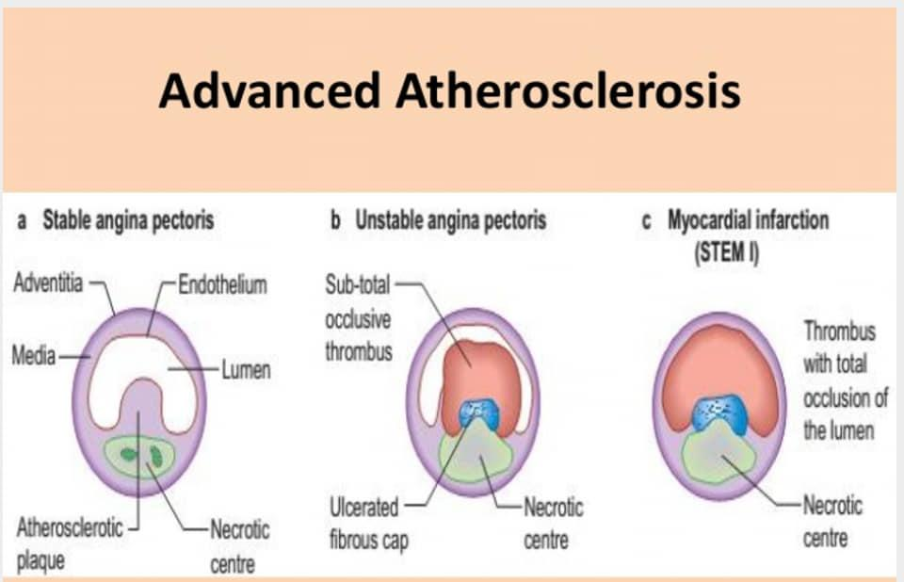
CLINICAL PRESENTATIONS OF CAD
Chronic coronary syndrome: chronic Stable angina
Acute coronary syndrome:
Unstable angina.
NSTEMI
STEMI
Heart failure.
Sudden cardiac death.

Slide 10

Acute Coronary Syndrome
Acute coronary syndrome (ACS) is a syndrome (set of signs and symptoms) due to decreased blood flow in the coronary arteries such that part of the heart muscle is unable to function properly or dies.
ACS should be distinguished from stable angina, which develops during exertion and resolves at rest. In contrast with stable angina, unstable angina occurs suddenly, often at rest or with minimal exertion, or at lesser degrees of exertion than the individual's previous angina ("crescendo angina").
New onset angina is also considered unstable angina, since it suggests a new problem in a coronary artery.
Acute coronary syndrome is usually caused by one of three problems: ST elevation myocardial infarction (STEMI, 30%), non ST elevation myocardial infarction (NSTEMI, 25%), or unstable angina (38%).
The most common symptom is chest pain, often radiating to the left arm or angle of the jaw, pressure-like in character, and associated with nausea and sweating.

Slide 11
ACUTE CORONARY SYNDROME CLINICAL DIAGNOSIS
SYMPTOMS OF ISCHEMIA
Chest pain (angina) or discomfort, often described as aching, pressure, tightness or burning
Nausea or vomiting
Indigestion
Shortness of breath (dyspnea)
Sudden, heavy sweating (diaphoresis)
Lightheadedness, dizziness or fainting
Unusual or unexplained fatigue
Feeling restless or apprehensive
Typical angina: sub-sternal chest discomfort with the following features:
Character ; “pressure,” “squeezing,” or “heaviness,” but never sharp or stabbing) and duration (typically minutes).
Provoked by exertion or emotional stress.
Relieved by rest or nitroglycerin (within several minutes)
Atypical angina: chest discomfort that meets 2 of the typical angina characteristics.
‹#›

Slide 12
ACS Signs
Sinus tachycardia or brady arrhythmia.
Hypertension (due to pain or as a chronic predisposing risk factor)or hypotension (cardiogenic shock).
Pallor , irritability
Raised JVP or normal.
S3 gallop if left ventricular function is impaired .
S4 gallop due to stiff ventricle.
Murmur of mitral incompetence or vsd from ruptured affected myocardium.
Pulmonary crepitation if heart failure occurs.

Slide 13
ACS Investigations
ECG
for Elevated ST segment
NO
Yes
NSTEMI/UA
STEMI
Troponin
+ ve
- ve
NSTEMI
UA

Slide 14
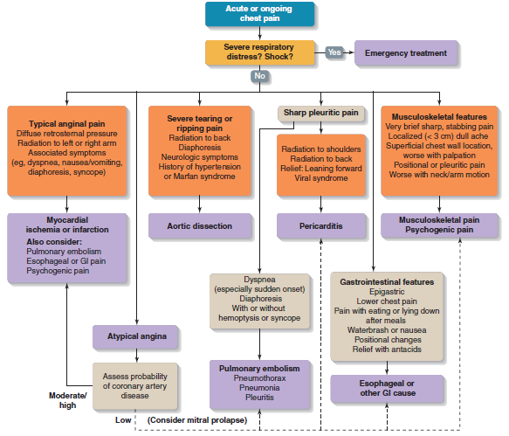
Pulmonary embolism.
Aortic dissection.
Pneumothorax
Takotsubo syndrome:
manifests by chest pain,
ST elevation in ECG,
positive cardiac markers,
Normal coronary angio.

Slide 15

Types of CHEST PAIN/ ANGINA PECTORIS
Ishemic Chest Pain
TYPICAL ANGINA PECTORIS / ISCHEMIC CHEST PAIN :
Discomfort in the chest and/or adjacent areas (jaw, shoulder, back, arm)
ATYPICAL ANGINA / NON-ISCHEMIC CARDIAC CHEST PAIN
Chest pain that meets 1 or none of the typical angina characteristics e.g. Pericardial chest pain
ATYPICAL ANGINA / NON-CARDIAC CHEST PAIN
Sharp chest pain that increases with inspiration or cough e.g. Pleuritic chest pain
Cardiac Non-ishemic Chest Pain
Noncardiac Chest Pain

Slide 16
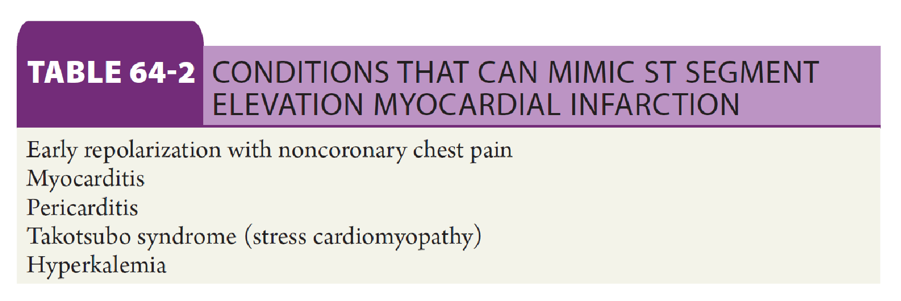

Slide 17
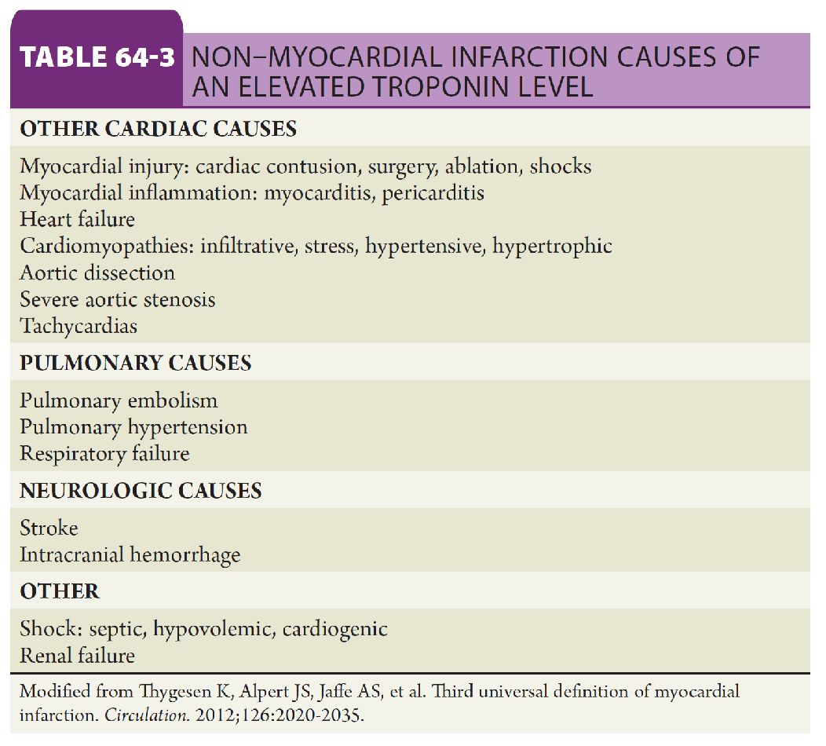

Slide 18
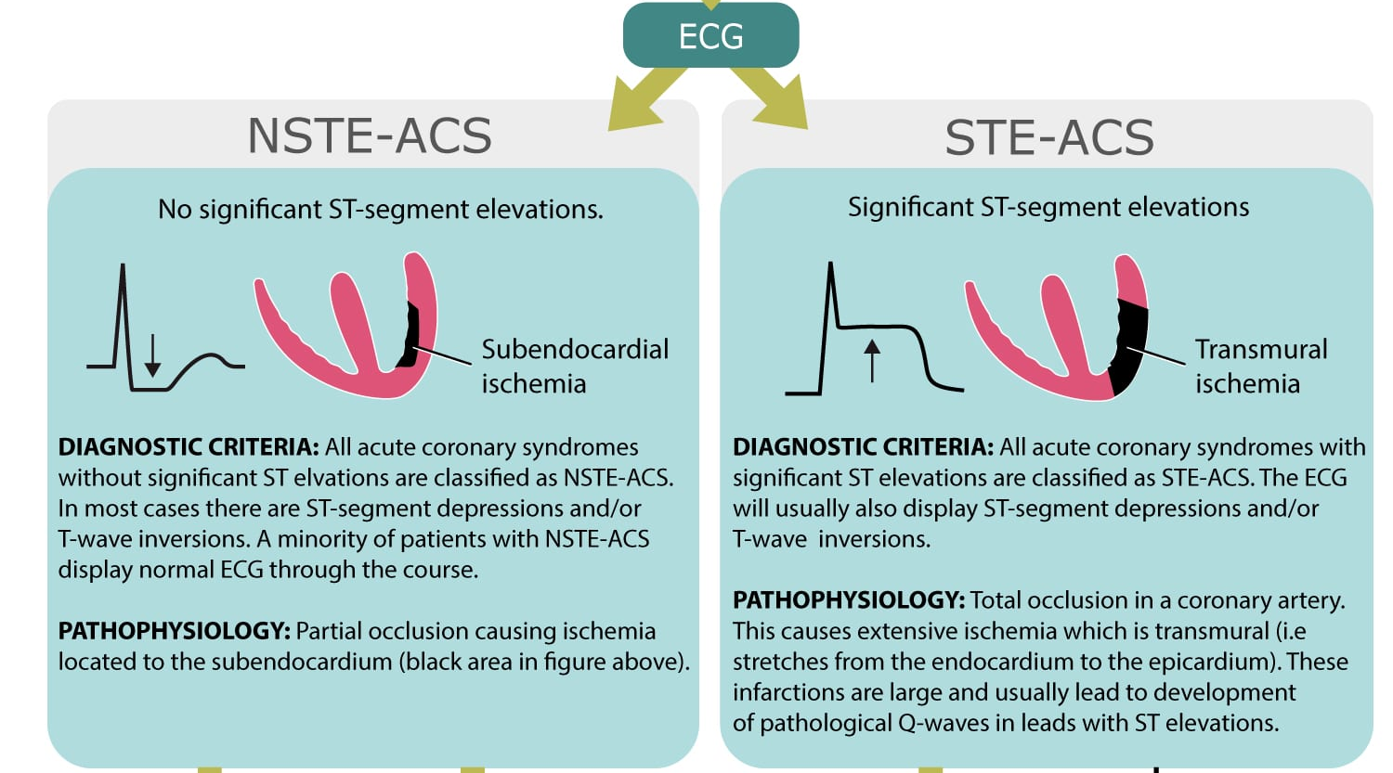
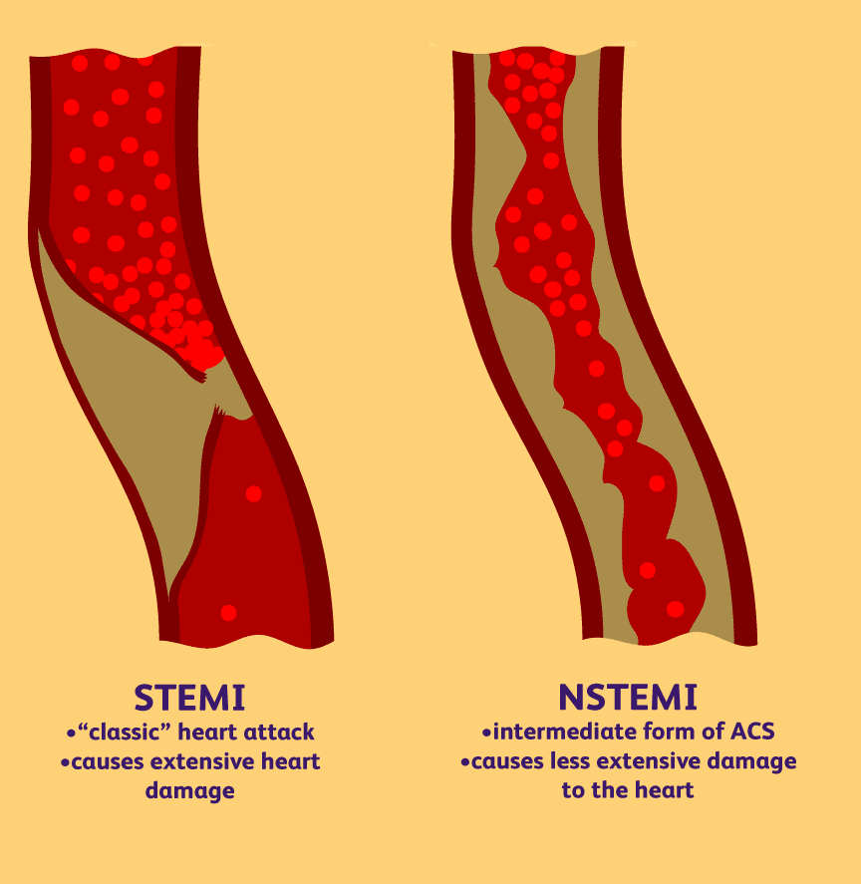

Slide 19
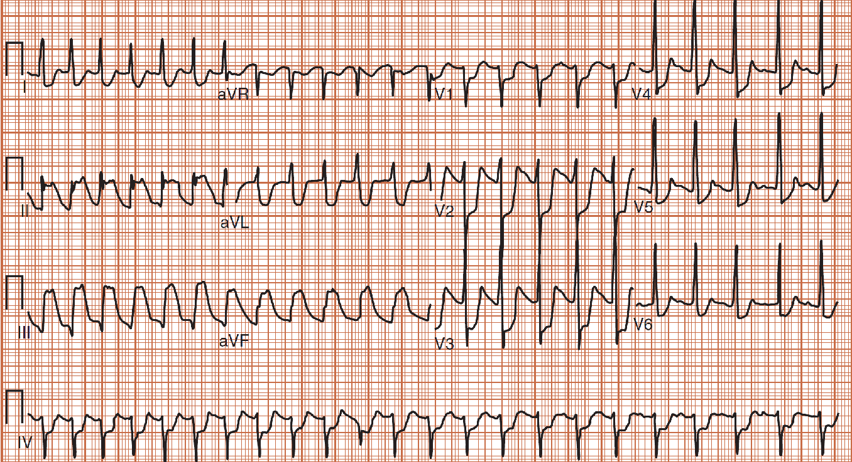
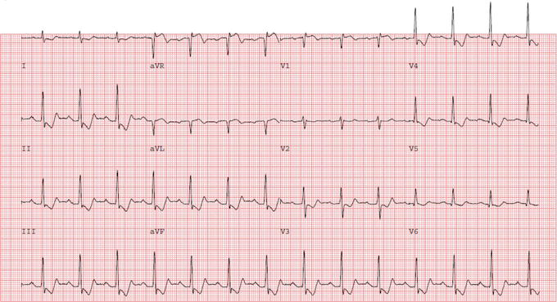
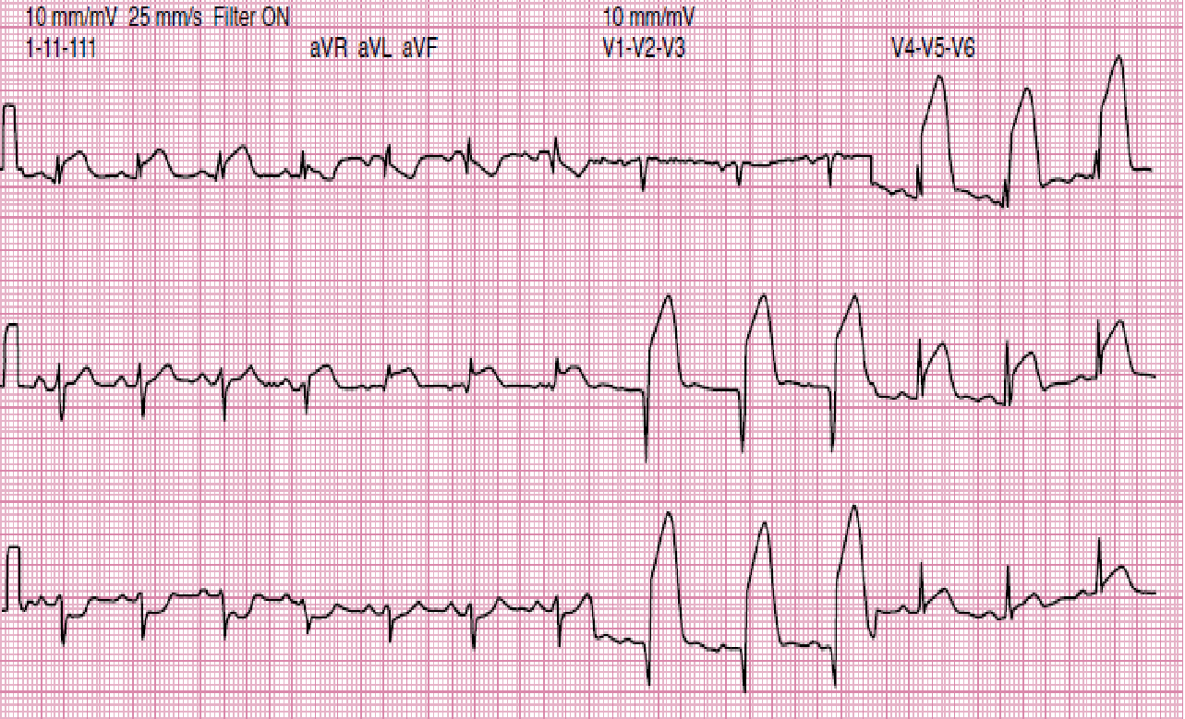
Diagnosis Of ACS
-ECG: serial ECGs are needed.
-Cardiac markers.
-Others.

Slide 20
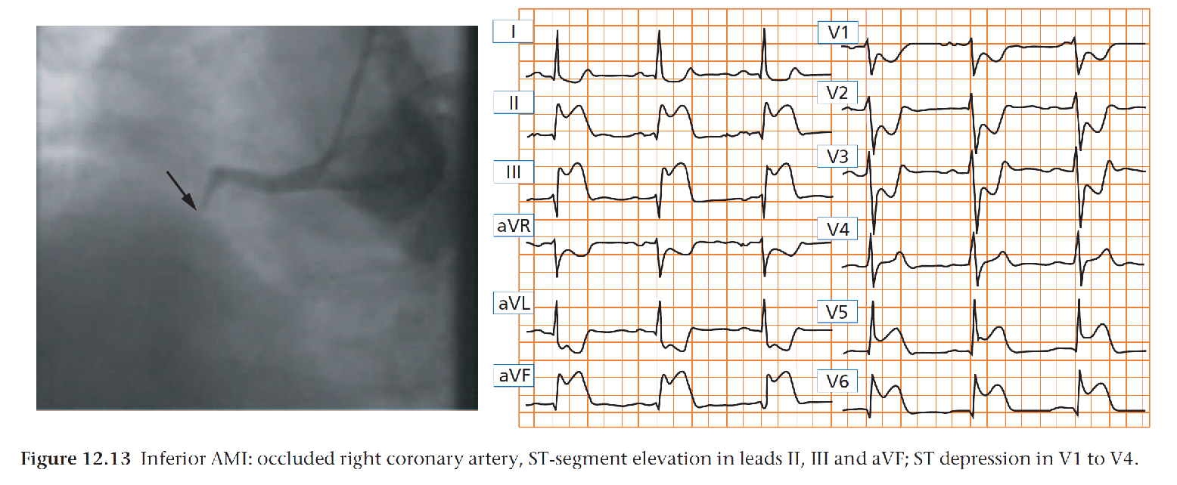
STEMI

Slide 21
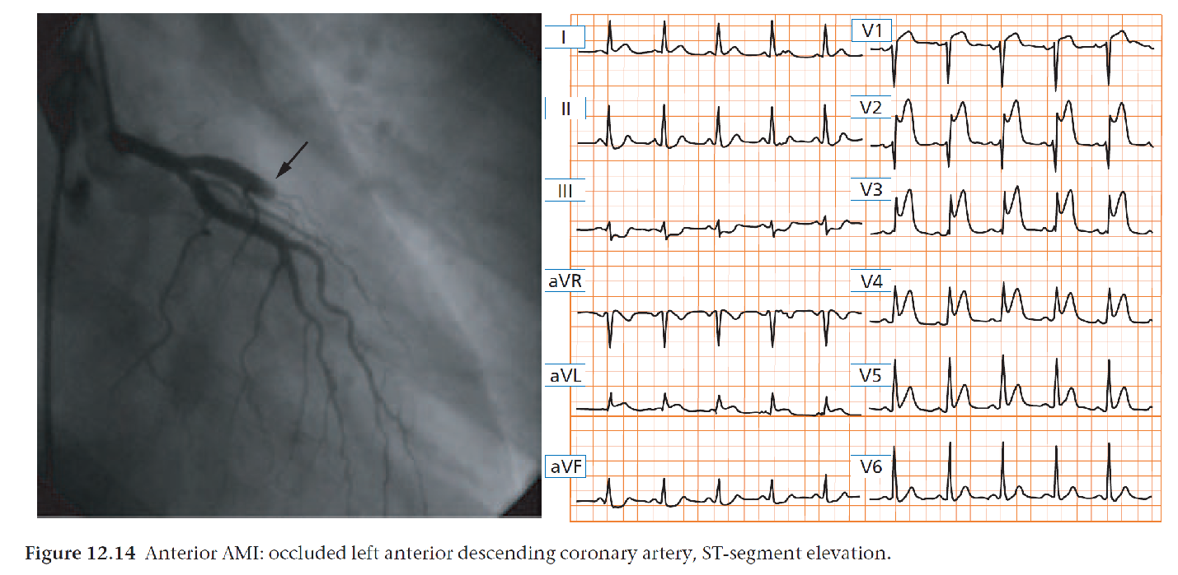

Slide 22
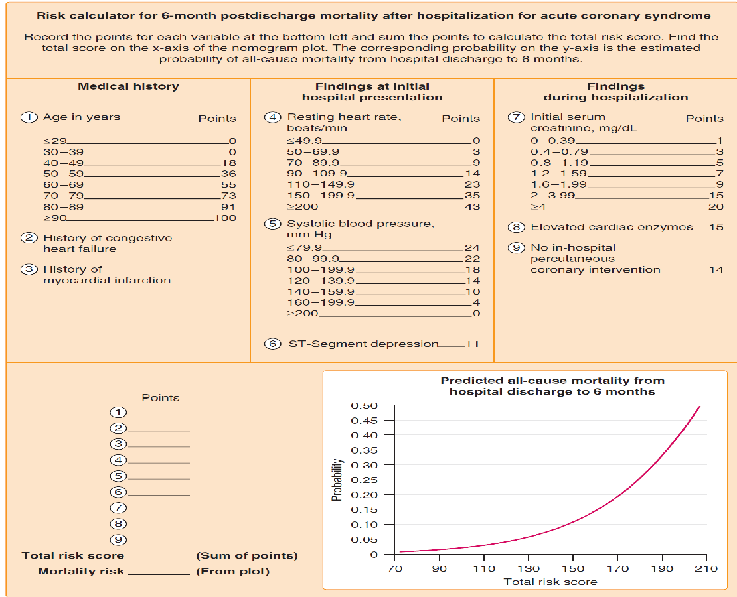
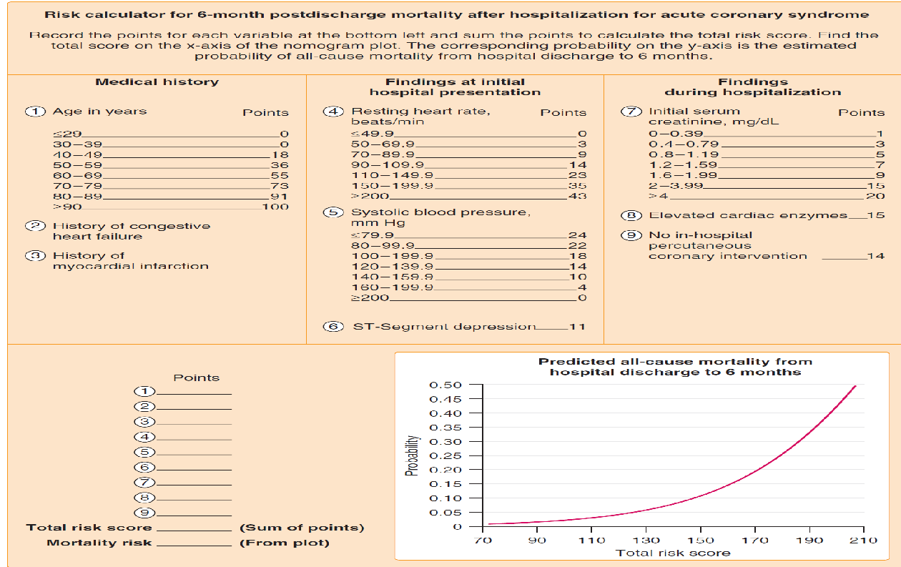

Slide 23
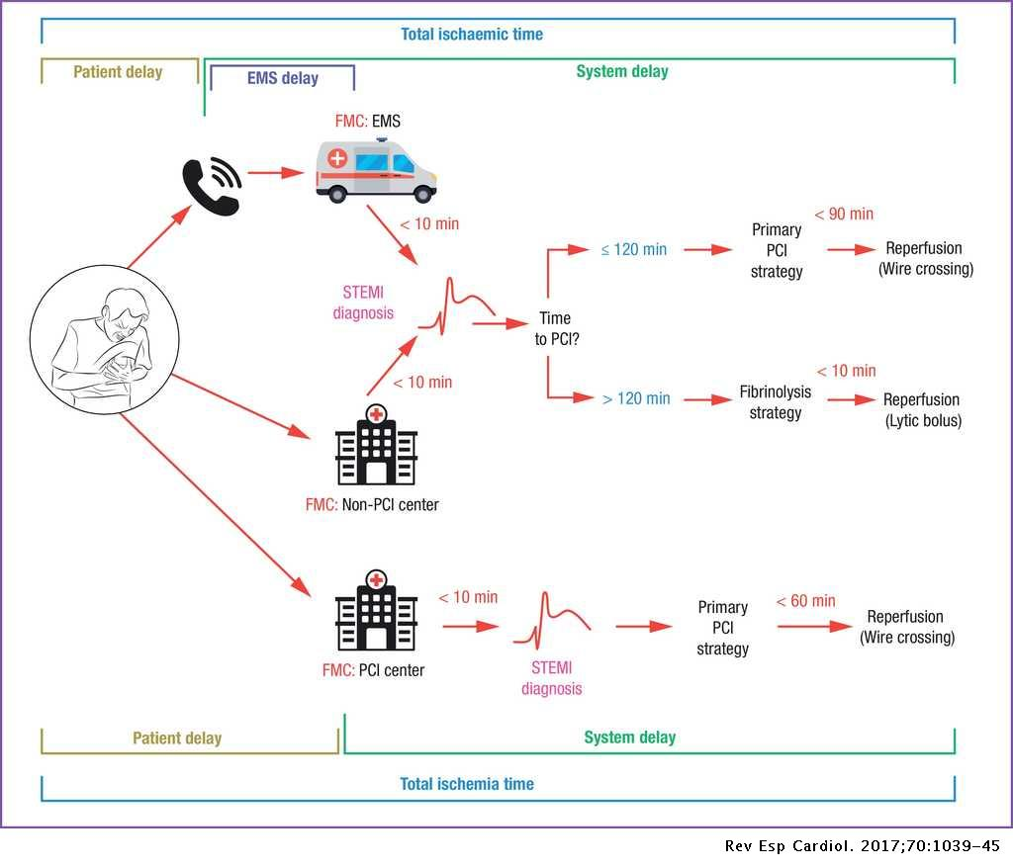
STEMI MANAGEMENT=
REPERFUSION

Slide 24
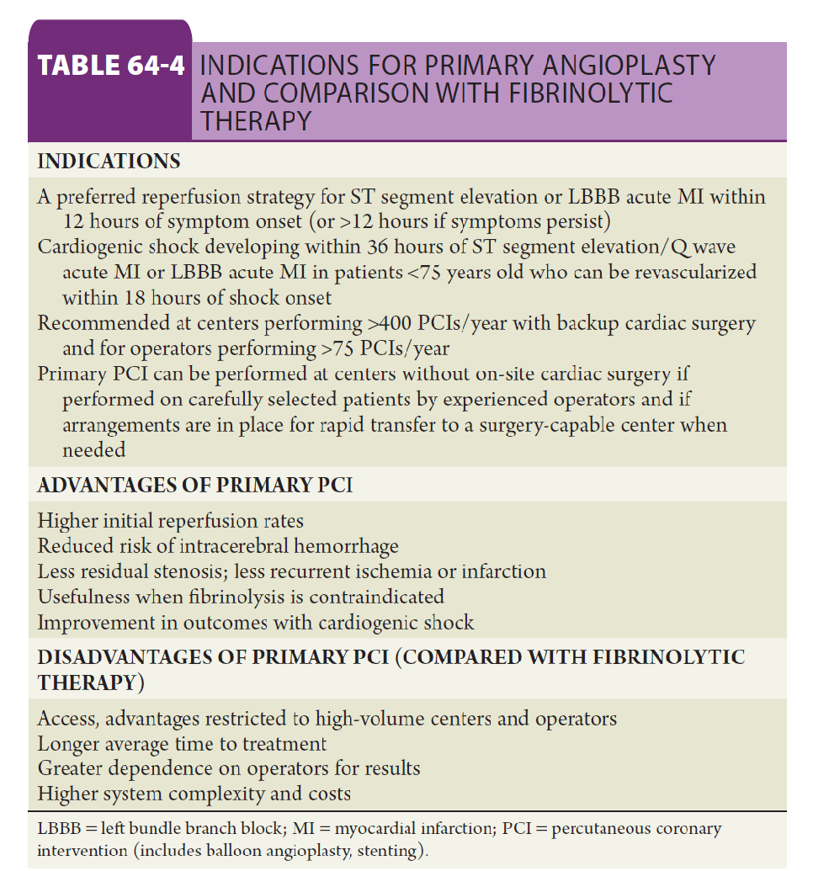

Slide 25
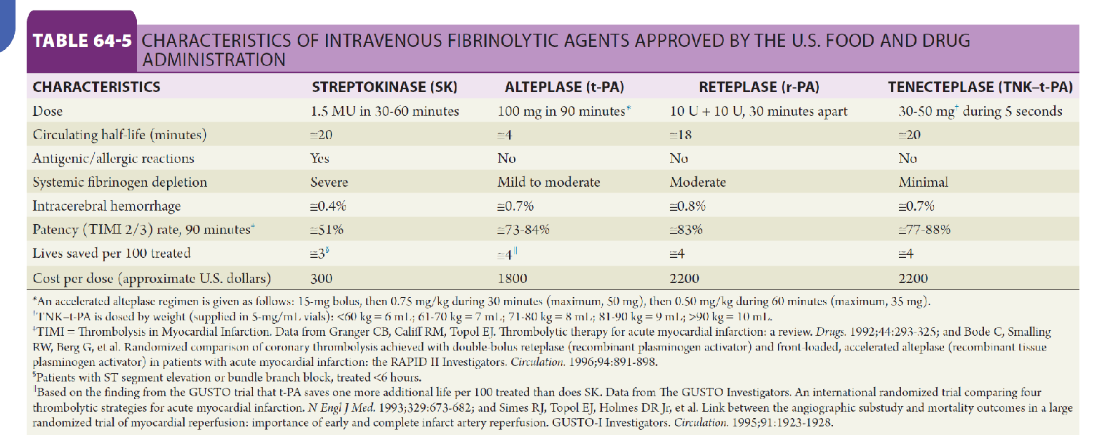

Slide 26
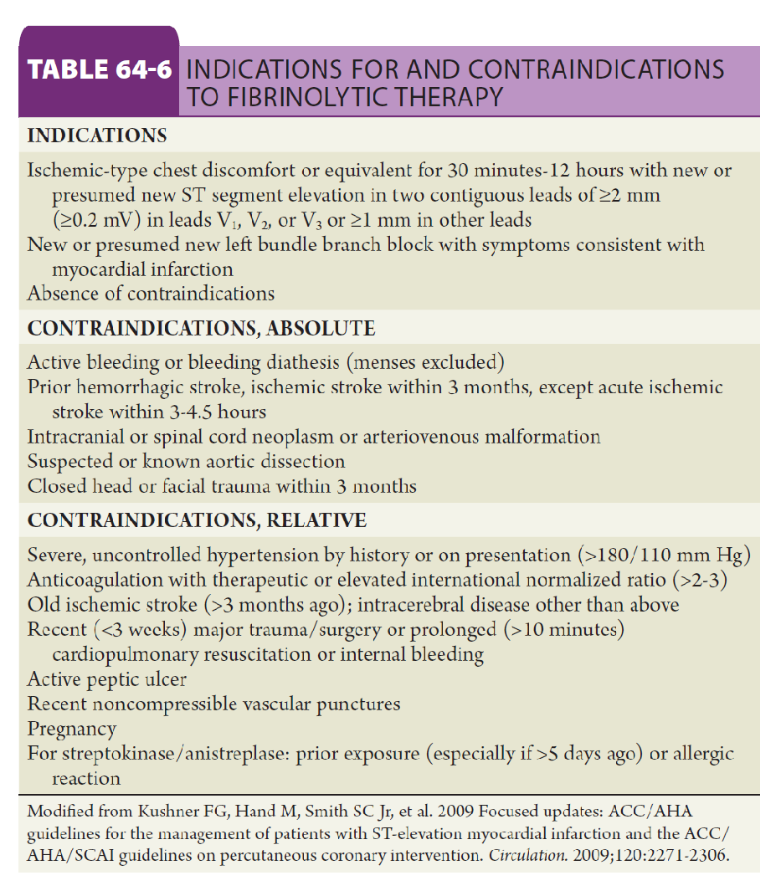
THROBOLYTIC THERAPY
Reduce hospital mortality by 25-50%
Used when catheter team is not available and when no absolute contraindications
e.g. Alteplase( human TPA)
given as IV bolus followed by infusion
Better survival rate than other thrombolytic agents like streptokinase.
Their major risk is catastrophic bleeding specially if concomitant use o heparin, hypertension, old age above 75 years.

Slide 27
REPERFUSION THERAPY FOR STEMI
PPCI
BEST TREATMENT
THROMBOLYTIC
SECOND BEST IF PPCI IS NOT POSSIBLE
CABG
RARE MOSTLY WITH MECHANICAL COMPLICATIONS
JUST MEDICAL TREATMENT
ONLY FOR LATE PRESENTERS BEYOND 48 HOURS

Slide 28
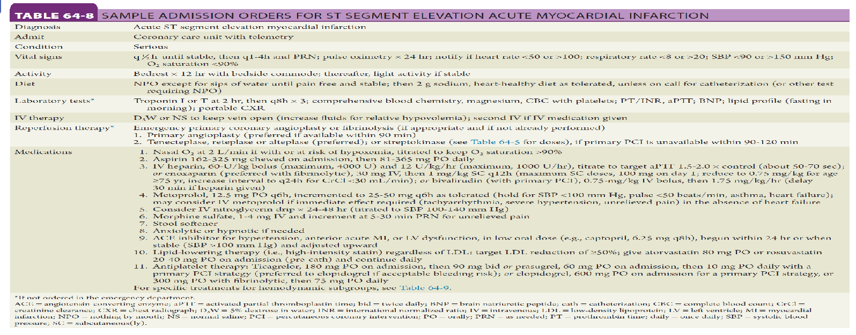

Slide 29
Prognosis following STEMI
5-10% of hospitalized patients will die
Infarct size/severity
Age
Comorbid conditions
Development of heart failure or hypotension
Post-discharge mortality rates
6-8% within first year, half of these within first 3 months 4% per year following first year
LV dysfunction
Residual myocardial ischemia
Ventricular arrhythmias
History of prior MI

Slide 30
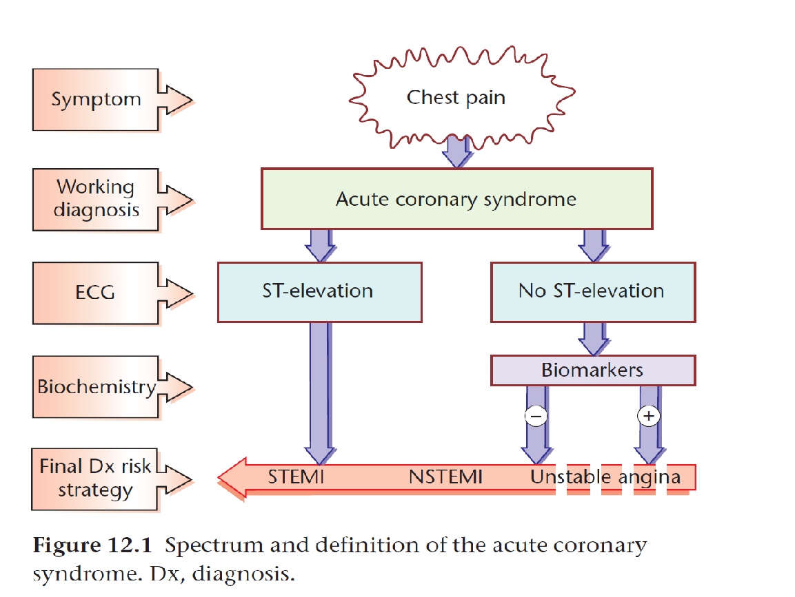
NSTEMI AND UNSTABLE ANGINA

Slide 31
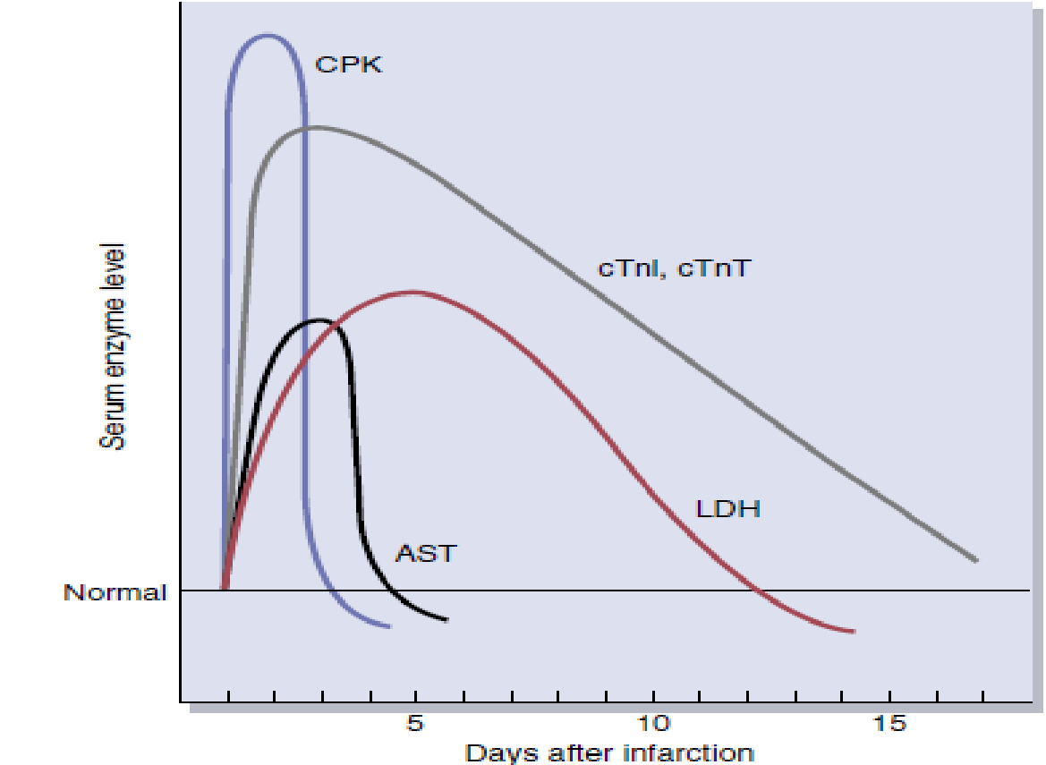
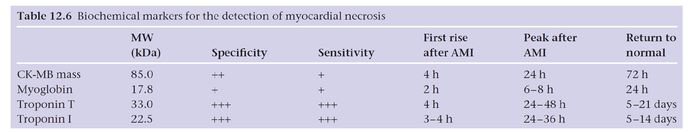
Diagnosis Of ACS
A rise/ fall of serum markers
Typical time course for the detection of enzymes released after myocardial infarction.
AST, serum aspartate aminotransferase;
CPK, creatine kinase;
cTnI, cardiac troponin I;
cTnT, cardiac troponin T;
LDH, lactate dehydrogenase

Slide 32
INVESTIGATIONS Of ACS
ECG
Cardiac enzymes
Chest x-ray:
- Pulmonary edema.
- heart size is often normal .
Echocardiography:
Assess ventricular ejection fraction.
Segmental wall motion abnormalities
Detect complications: Mural thrombus, cardiac rupture, VSD, mitral regurge, or pericardial effusion.
Coronary angiogram
This procedure uses X-ray imaging to see heart's blood vessels.
It is also used for PCI.

Slide 33
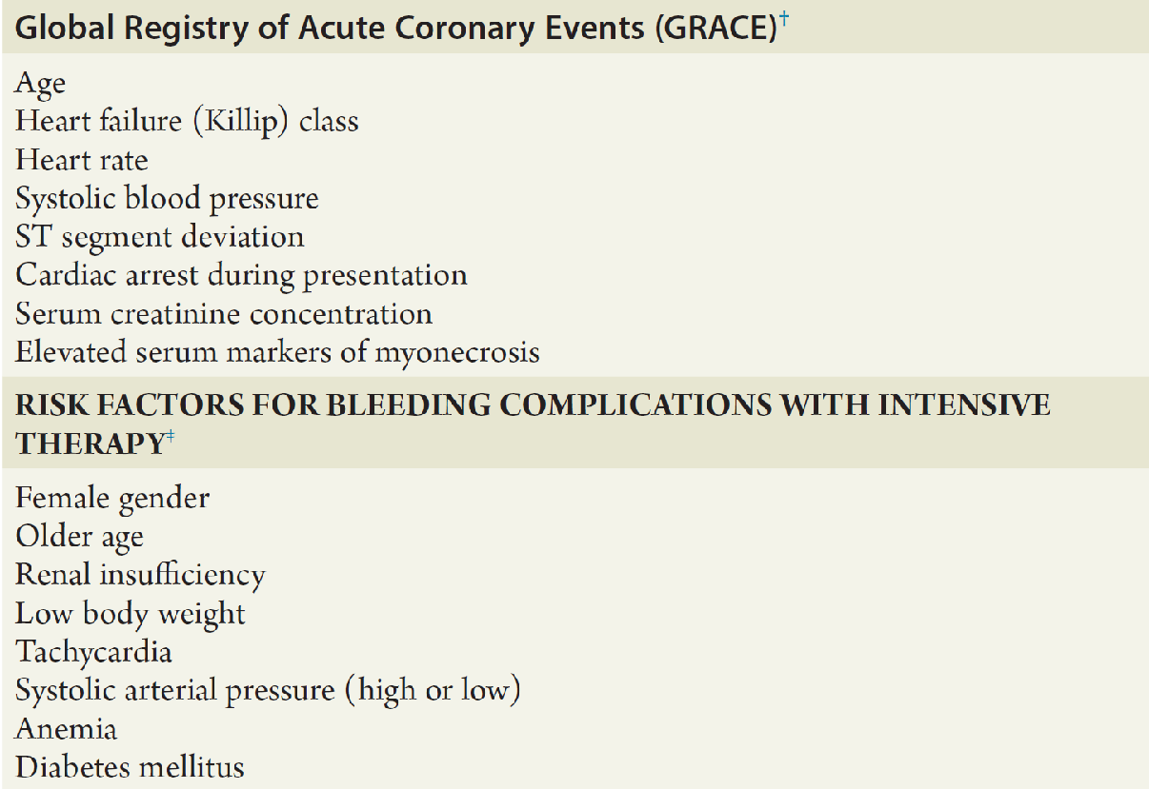

Slide 34
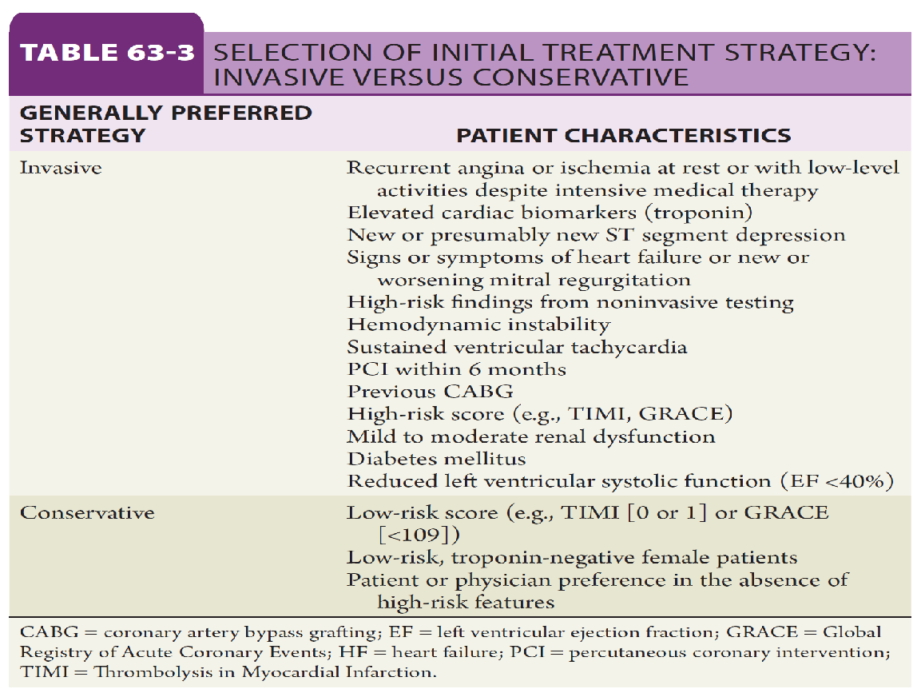
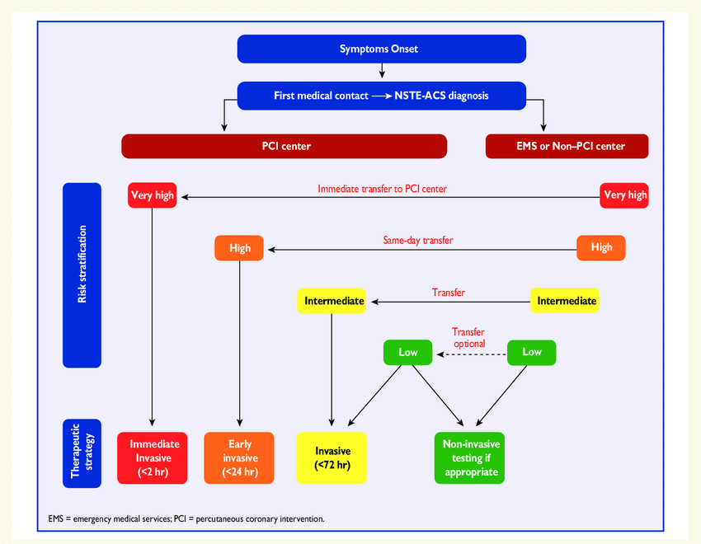
REPERFUSION DEPENDS ON RISK STRATIFICATION

Slide 35
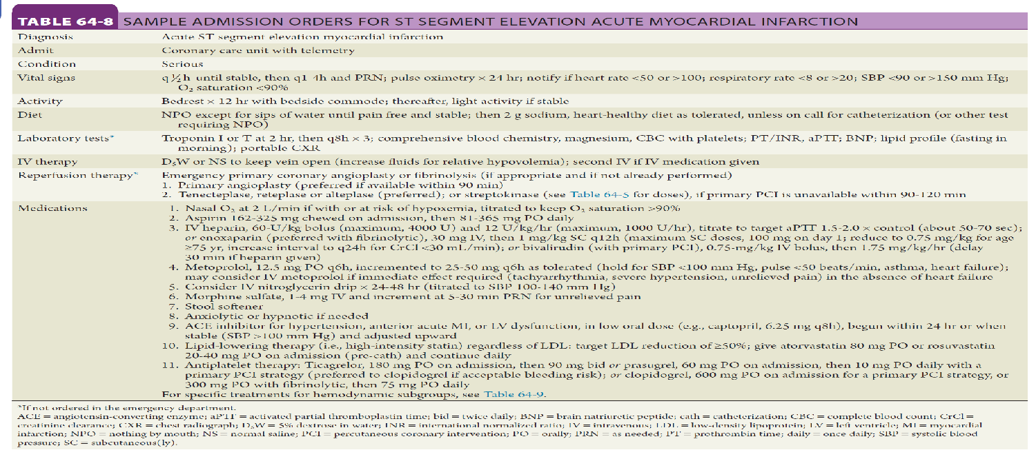
PHARMACOLOGIC THERAPY FOR ACS

Slide 36
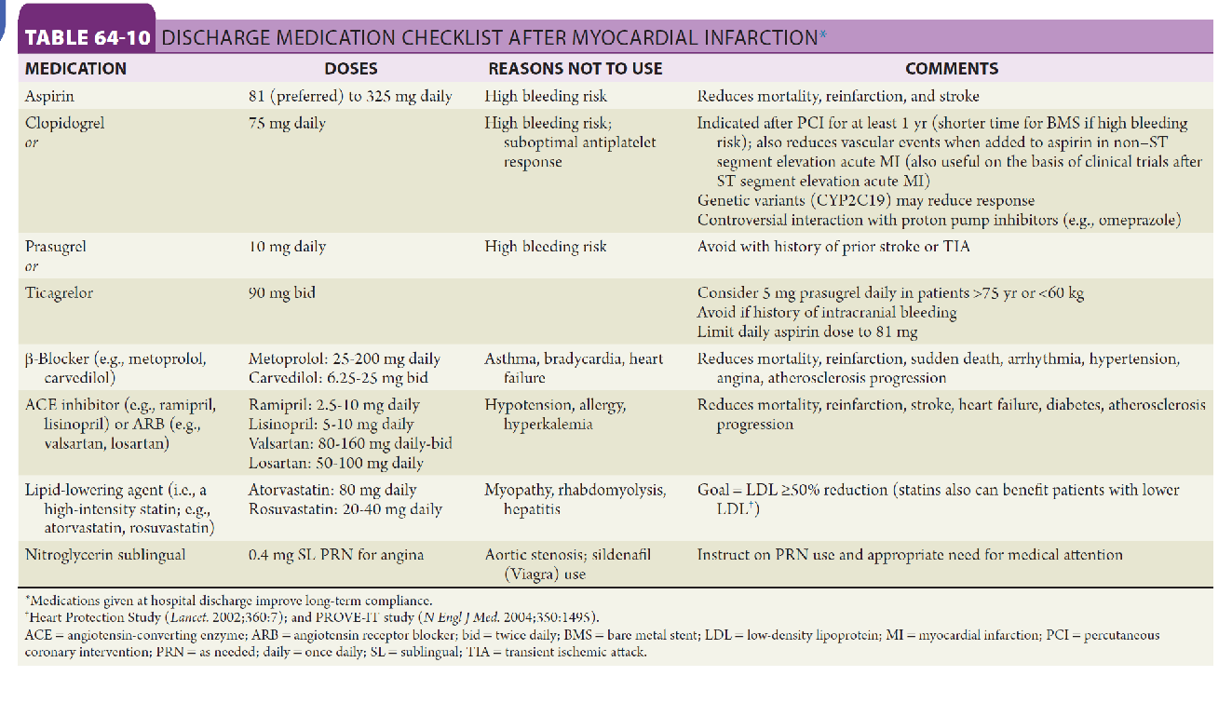

Slide 37
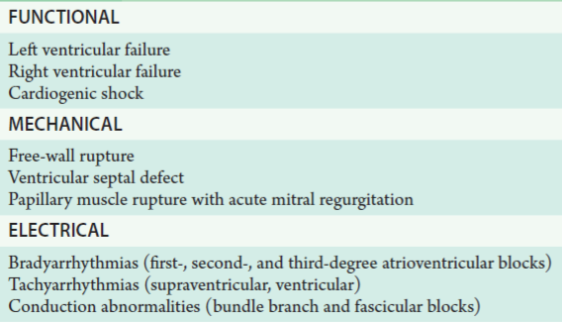
Complications Of Acute MI

Slide 38
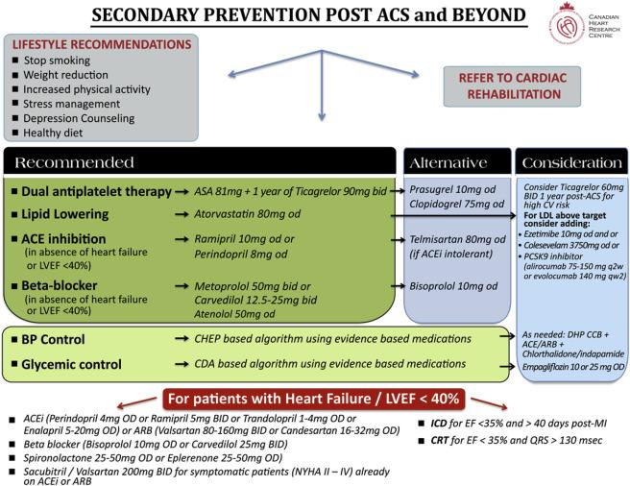
SECONDARY PREVENTION POST ACS
The coordinated multifaceted interventions designed to optimize a cardiac patient's physical, psychological, and social functioning in addition to stabilizing, slowing, or even reversing the progression of the underlying atherosclerotic process, thereby reducing morbidity and mortality.
It includes 4 phases starting with conditioning from acute event or post CABG to make the patient functionally independent, and to prepare for discharge from hospital , nutritional counseling , and establish secondary prevention targets.
It includes also early ambulation and gradual exercise programs under supervision as well as psychological management.

Slide 39
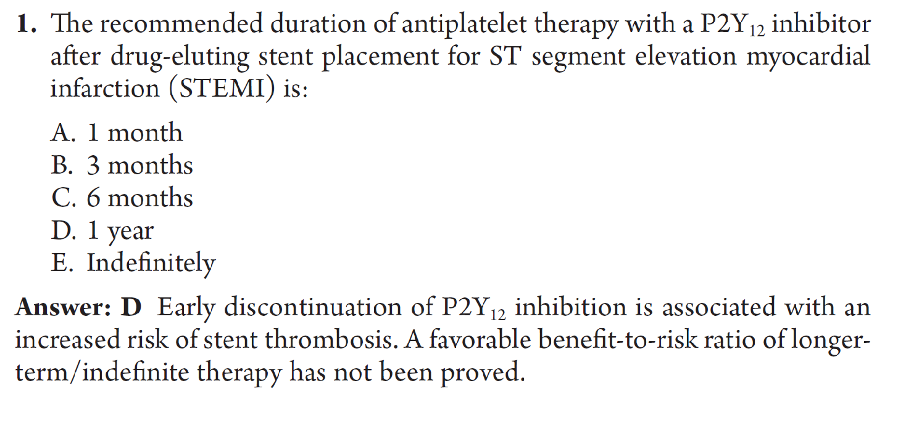
Quiz

Slide 40
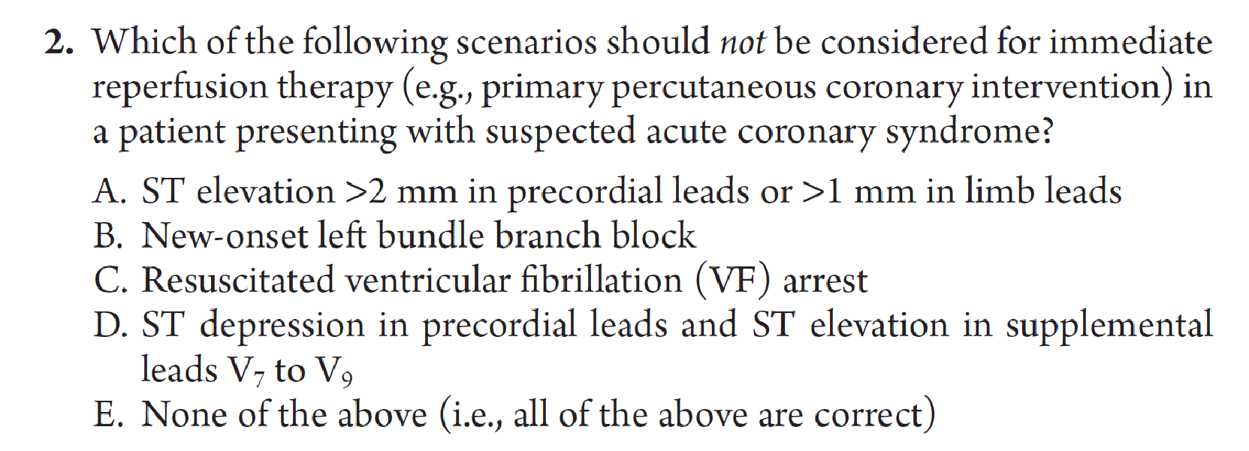
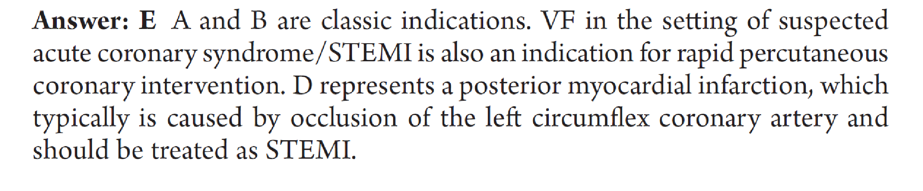

Slide 41
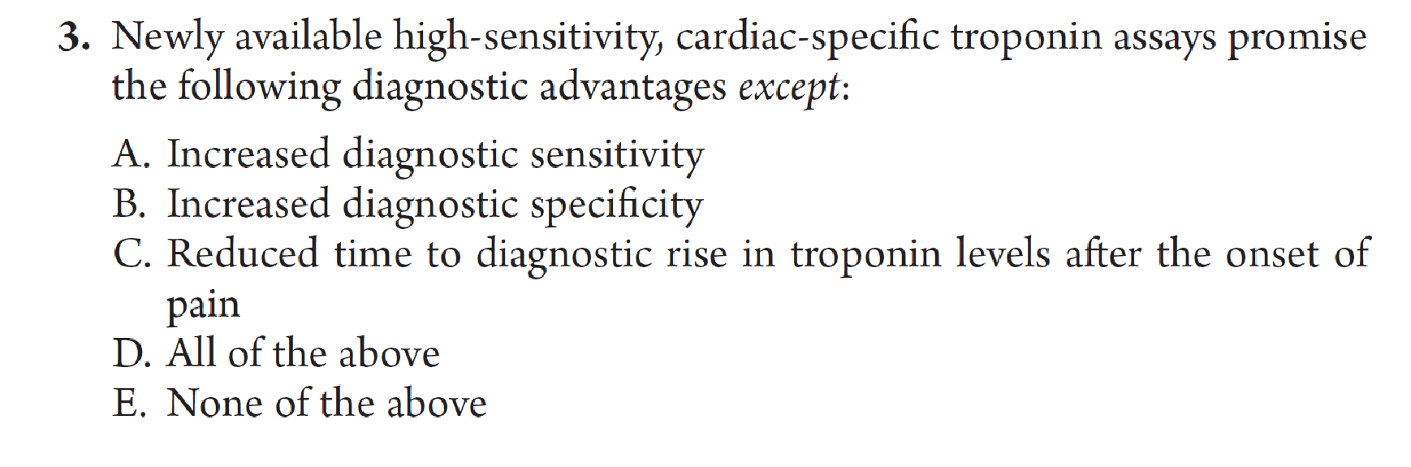
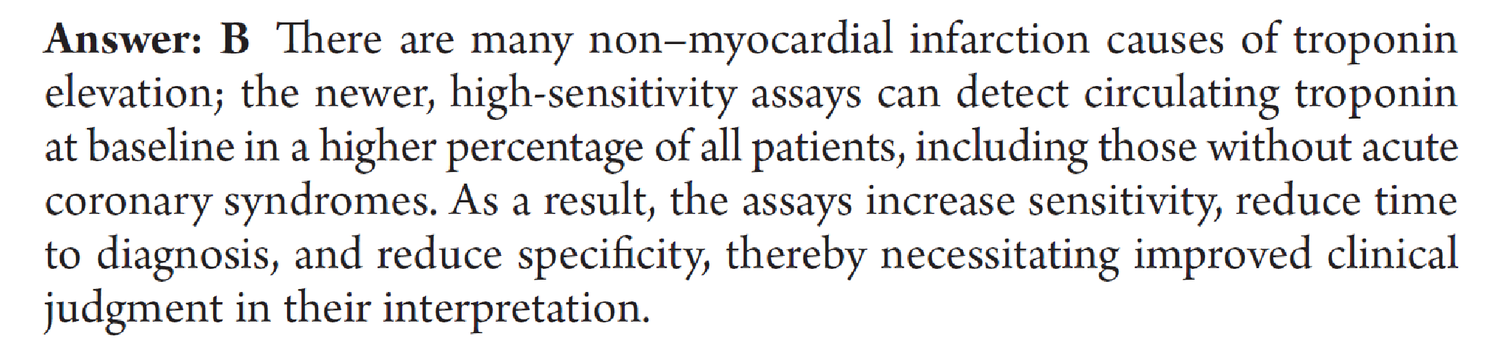

Slide 42
Quiz
65 years old man retired, was presented to emergency department by 6 hours history of retrosternal crushing chest pain radiating to jaw , he had an episode of vomiting , he has history of diabetes and hypertension for 10 years but not well compliant to the medication, he is smoker for the last 30 years 10-15 cig per day, and stopped 2 years ago.
He has family history of DM and Dyslipidemia.
On examination:
pulse :115 per minute regular
BP:160/105 lying
RR: 26 /min

Slide 43
Temperature: normal
Systemic exam : the patient looks sweaty.
there is xanthelasma
There is Arcus senelis
No pallor, or jaundice or cyanosis.
Tobacco staining.
JVP not elevated .
No carotid bruit.
Cardiac exam :
Normally placed apex, heaving in character.
S2 is accentuated over the aortic area.

Slide 44
Lung examination showed no abnormality
No organomegaly
No pedal edema.
Review of other systems showed no abnormality.
What is your differential diagnosis?
How to diagnose ?
How to manage , immediate and late management ?

Slide 45
Take home message
All patients with suspected ACS should have good assessment by detailed history, physical examination and risk factor identification for proper and early management.
Identification & differentiation between typical and atypical presentation of ACS is mandatory.
Early diagnosis and management of ACS is crucial and it affects the functional status of patients post insult.

Slide 46
What To Read
The Patient History An Evidence-Based Approach to Differential Diagnosis.
Toronto notes.
Andreoli and Carpenter's Cecil Essentials of Medicine.

Slide 47
Thank You

